Slide 1
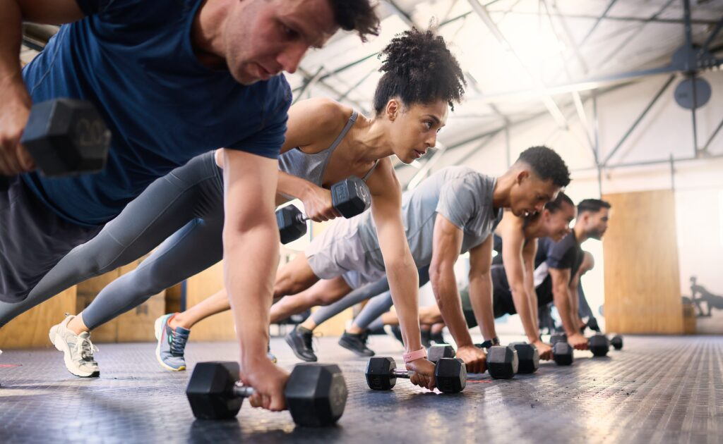
All
Fitness
Sep-2026
Byron Giraldo
Guillermo Moya
Harrison Pinto
Manuel Díaz

Slide 2
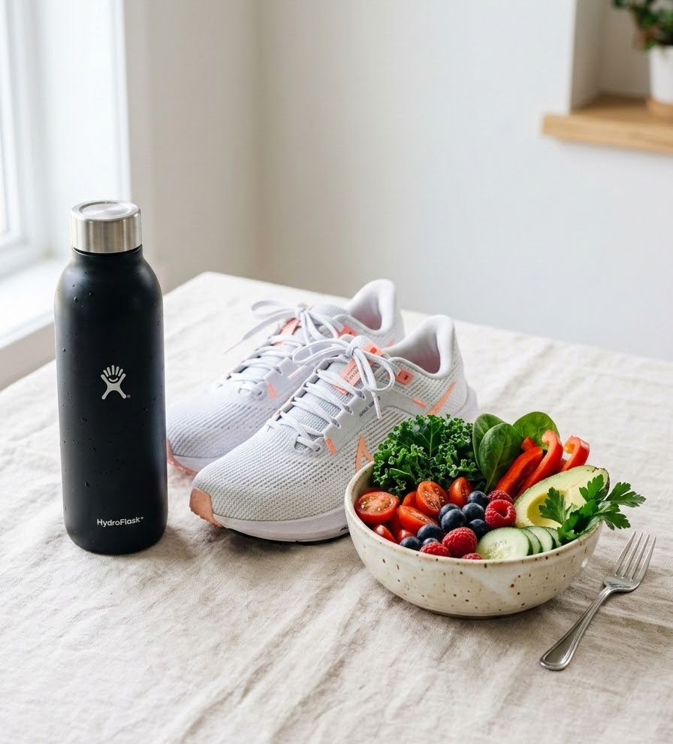
All Fitness
EL DESAFÍO
“
Muchas personas tienen dificultades para mantener una rutina de ejercicio y alimentación que realmente se adapte a sus necesidades.

Slide 3
¿Qué proponemos?
All Fitness utiliza Inteligencia Artificial para analizar la información del usuario y generar un ecosistema de bienestar personalizado.
Rutinas Personalizadas
Planes de entrenamiento dinámicos diseñados de forma inteligente que evolucionan junto con tus objetivos, condición física y progreso diario.
Nutrición Inteligente
Recetas y recomendaciones alimentarias adaptadas con precisión a tus preferencias, requerimientos nutricionales y estilo de vida.
La idea clave
Una sola aplicación ➔ Un perfil unificado ➔ Recomendaciones 100% adaptadas a ti

Slide 4
¿Qué nos diferencia?
Nuestra propuesta de valor: Aplicaciones tradicionales vs All Fitness
Rutinas generales
➔
Rutinas personalizadas
La principal diferencia
Integrar entrenamiento y alimentación en una misma experiencia, utilizando un perfil unificado y considerando variables clave como objetivos, tiempo, equipamiento y preferencias alimentarias.
Alimentación separada
➔
Ejercicio + alimentación
Configuración manual
➔
Generación mediante IA
Servicios independientes
➔
Una experiencia integrada
Referentes: Fitbod, Freeletics, Zing Coach y FitOn

Slide 5
¿Cómo se llevará a cabo?
Aplicación y modelo de negocio para el ecosistema All Fitness
Plataforma y Desarrollo
La base tecnológica que soportará nuestra solución de bienestar inteligente, optimizada para un alto rendimiento y adaptabilidad de pantallas.
Android 12L — API 32
Diseñada específicamente para aprovechar las ventajas de diseño adaptativo en dispositivos plegables, tablets y pantallas grandes.
Modelo de Negocio
Esquema Freemium + Anuncios
Funciones principales de entrenamiento y nutrición gratuitas para garantizar el acceso global.
Generación de ingresos constantes mediante la integración de publicidad no intrusiva.
Futuro plan Premium para usuarios que buscan dar el siguiente paso en su entrenamiento.
Funcionalidades adicionales avanzadas y una experiencia completamente libre de anuncios.

Slide 6
In a few words, explain why you joined the team. Hype yourself up and let everyone know what they should expect from you in the future.

Slide 7











What I’m good at
Show everyone a picture of you at your best!
Skill 1
Skill 2
Skill 3
Sports & Games
Skill 4
Skill 5

Slide 8
Competence
Skill
Competence
Ability
Ability
Ability
Competence
Skill
Competence

Slide 9







What I’m good at
Name a skill
Name a skill
Talk about an area of expertise. It can be related to your job, but it doesn’t have to be. For example, you might be good at fishing, singing, or basketball.
Talk about an area of expertise. It can be related to your job, but it doesn’t have to be. For example, you might be good at fishing, singing, or basketball.
Name a skill
Name a skill
Talk about an area of expertise. It can be related to your job, but it doesn’t have to be. For example, you might be good at fishing, singing, or basketball.
Talk about an area of expertise. It can be related to your job, but it doesn’t have to be. For example, you might be good at fishing, singing, or basketball.

Slide 10
What I’m good at
Name a skill
Name a skill
Name a skill
Name a skill
Talk about an area of expertise.
It can be related to your job, but it doesn’t have to be. For example, you might be good at graphic design, singing, or basketball.
Talk about an area of expertise.
It can be related to your job, but it doesn’t have to be. For example, you might be good at graphic design, singing, or basketball.
Talk about an area of expertise.
It can be related to your job, but it doesn’t have to be. For example, you might be good at graphic design, singing, or basketball.
Talk about an area of expertise.
It can be related to your job, but it doesn’t have to be. For example, you might be good at graphic design, singing, or basketball.
Name a skill
Name a skill
Name a skill
Name a skill
Talk about an area of expertise.
It can be related to your job, but it doesn’t have to be. For example, you might be good at graphic design, singing, or basketball.
Talk about an area of expertise.
It can be related to your job, but it doesn’t have to be. For example, you might be good at graphic design, singing, or basketball.
Talk about an area of expertise.
It can be related to your job, but it doesn’t have to be. For example, you might be good at graphic design, singing, or basketball.
Talk about an area of expertise.
It can be related to your job, but it doesn’t have to be. For example, you might be good at graphic design, singing, or basketball.

Slide 11
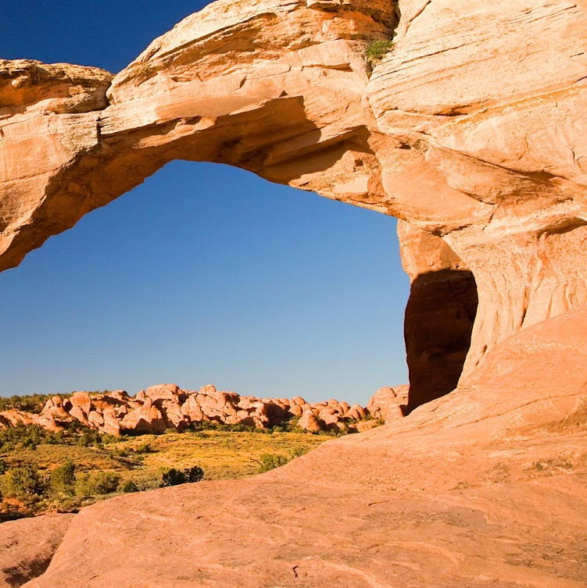
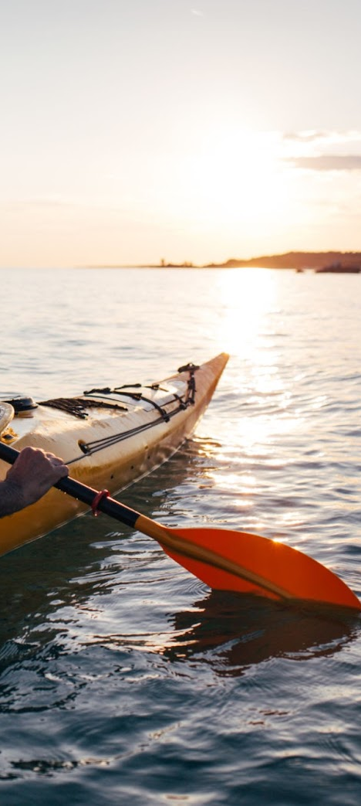
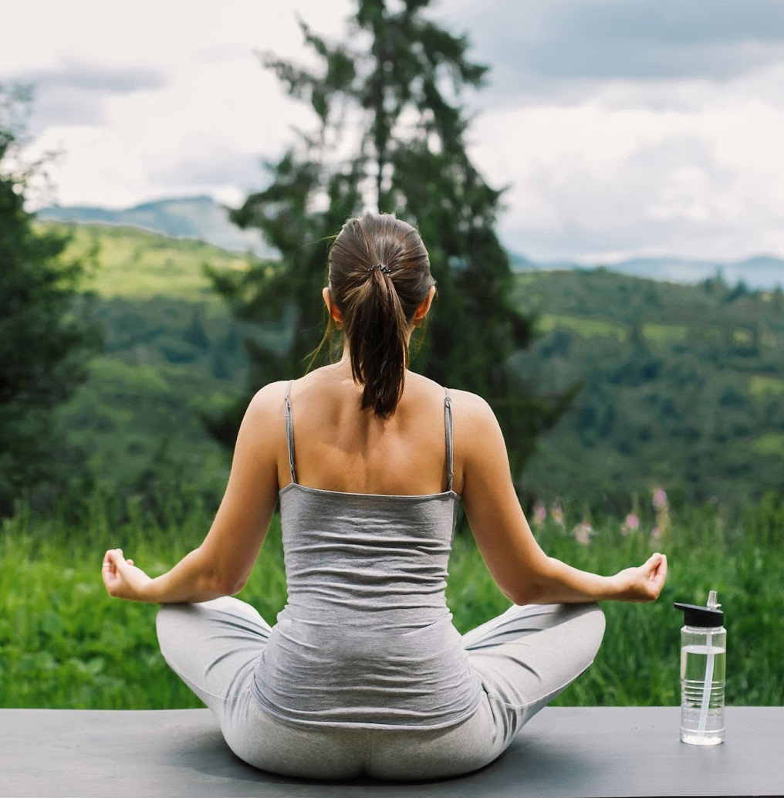

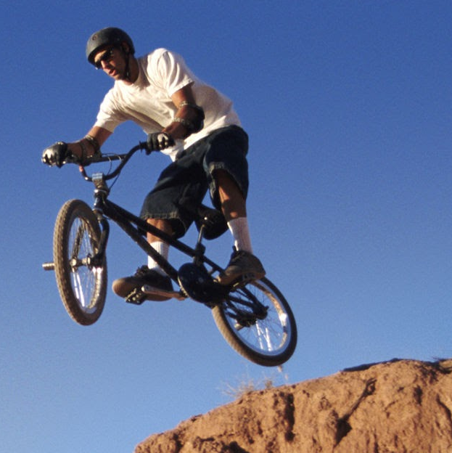
My hobbies and interests

Slide 12
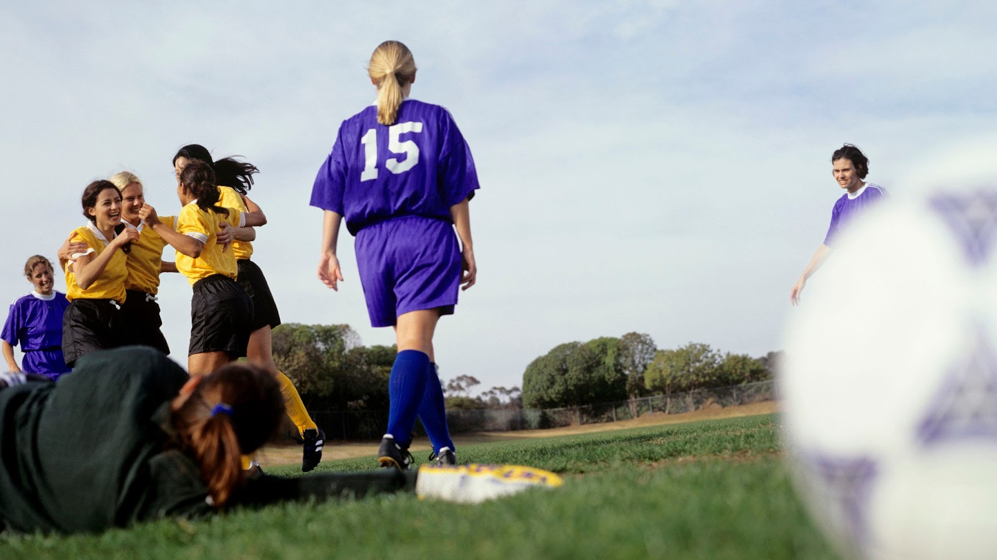

Let’s connect!
Share your contact information.
This can be your work email, your LinkedIn profile, your phone number – wherever you want team members to reach out.

Slide 13


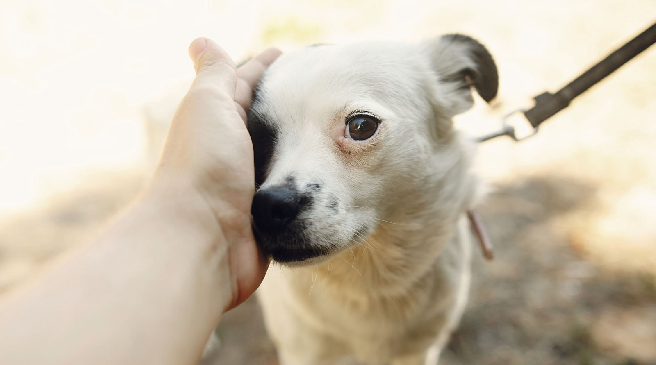
My hobbies and interests
Name an activity
Name an activity
Name an activity
Mention something you enjoy doing in your free time. This could be watching sports, reading books, or playing board games.
Mention something you enjoy doing in your free time. This could be watching sports, reading books, or playing board games.
Mention something you enjoy doing in your free time. This could be watching sports, reading books, or playing board games.

Slide 14


Your favorite tools
of the trade
Name a tool or resource
Talk about a tool or resource that helps you in your everyday work. This can be software, hardware, an app or website — even a life hack.
Name a tool or resource
Name a tool or resource
Talk about a tool or resource that helps you in your everyday work. This can be software, hardware, an app or website — even a life hack.
Talk about a tool or resource that helps you in your everyday work. This can be software, hardware, an app or website — even a life hack.
Logo
Logo
Logo

Slide 15

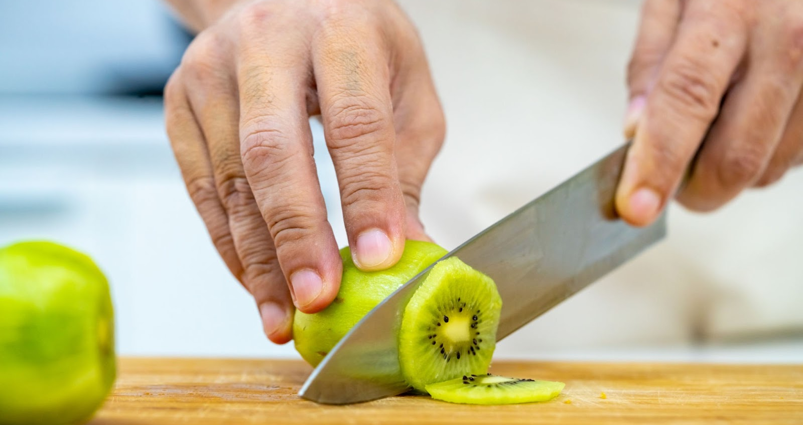

Did you know…
Share a fun fact about yourself
Share something unusual that makes you, you. It could be a gem of personal trivia, a surprising family connection, or a unique life experience.
Share a fun fact about yourself
Share a fun fact about yourself
Share something unusual that makes you, you. It could be a gem of personal trivia, a surprising family connection, or a unique life experience.
Share something unusual that makes you, you. It could be a gem of personal trivia, a surprising family connection, or a unique life experience.

Slide 16
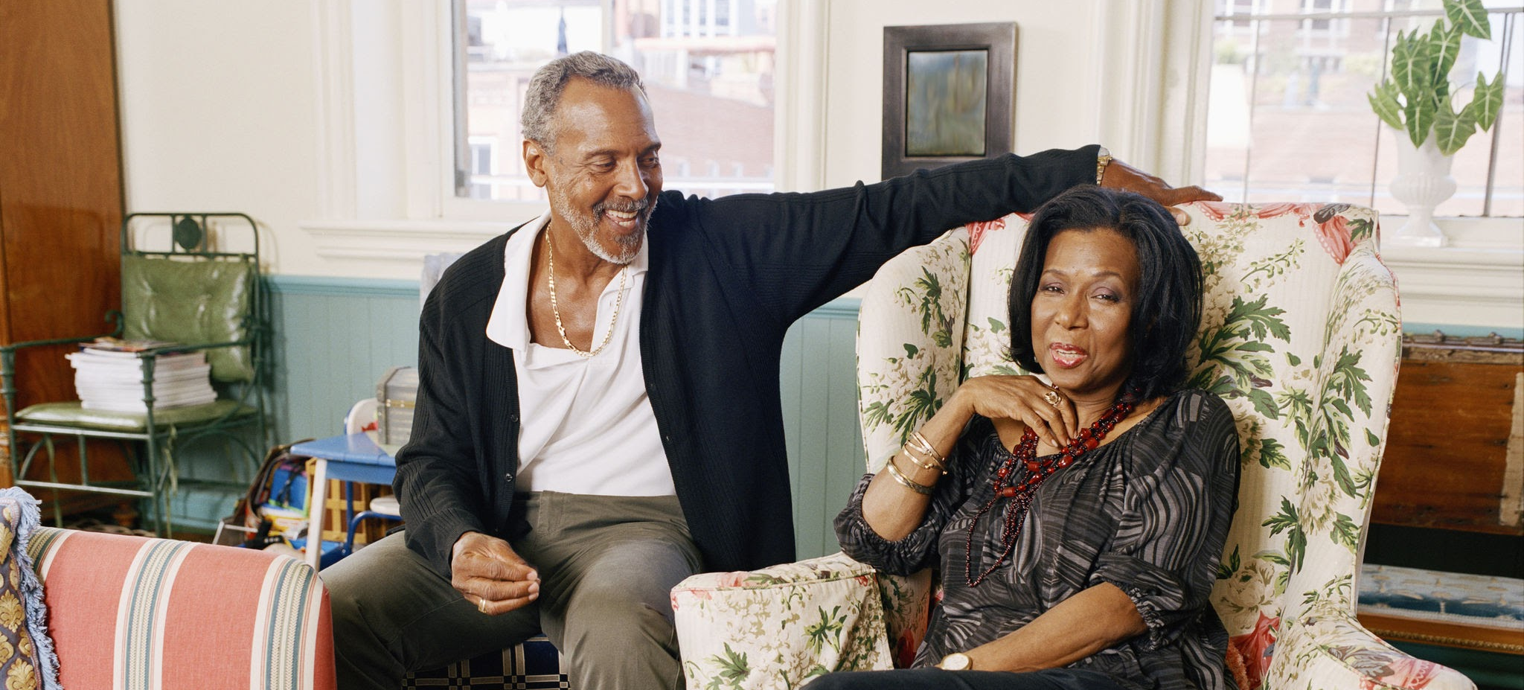


Did you know…
Share a fun fact
about yourself
Share something unusual that makes you, you. It could be a gem of personal trivia, a surprising family connection, or a unique life experience.
Share a fun fact about yourself
Share something unusual that makes you, you. It could be a gem of personal trivia, a surprising family connection, or a unique life experience.

Slide 17

What you want to achieve.
What you want to be.
Talk about a goal, hope or dream
It can be related to your work or your new role.
But it can also be a personal goal, such as a city you’d like to visit or a language you’d like to learn.

Slide 18
What you want to achieve.
Who you want to be.
Talk about a goal, hope, or dream
It can be related to your work or your new role.
But it can also be a personal goal, such as a city you’d like to visit or a language you’d like to learn.
Talk about a goal, hope, or dream
It can be related to your work or your new role.
But it can also be a personal goal, such as a city you’d like to visit or a language you’d like to learn.
Talk about a goal, hope, or dream
It can be related to your work or your new role.
But it can also be a personal goal, such as a city you’d like to visit or a language you’d like to learn.
Talk about a goal, hope, or dream
It can be related to your work or your new role.
But it can also be a personal goal, such as a city you’d like to visit or a language you’d like to learn.

Slide 19

Ask me
anything!

Slide 20
Thank you!
To conclude the presentation, write a few words about your future with the team and what you’ll achieve together.

